Slide 1
Intro [Tianchang] (build up significance) (2 min)
Explain what time series?
Why apple?
What are the periods and how much data we used?
Data preprocessing? – trade off, using data points vs fixing a period to predict?
Configuration (train/test)
(Performance interpretability tradeoff)
KNN (3 min) (Why, How it works?) [Jerome]
ARIMA (3min) [Shriya, Tianchang, JW (Seasonal & others)]
LSTM (3min) [Amy, Kai Chao]
What is it
Preprocessing
Performance metrics
Limitations
Evaluate the results. (2min) (How does it performs? Why it performs this way)
Expected: Daily < Monthly < Quarterly RMSE
Conclude which period suits the models (2min)
60% Percent weekend 6/7 Nov after evening
Rubrics: https://docs.google.com/document/d/1zOQ3BC5IKXKWRk1eotLfjVxbzL3EjIKuPLMjyHMwiyQ/edit

Slide 2
1 KNN Regression

Slide 3
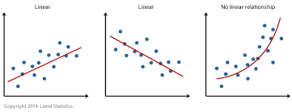
Why KNN and not Linear Regression?
Linear regression as a parametric model, has several advantages:
Easy to fit
Easy to Interpret
However, it assumes that the data is linear which is a limitation.
Notes:
https://bookdown.org/tpinto_home/Regression-and-Classification/k-nearest-neighbours-regression.html

Slide 4
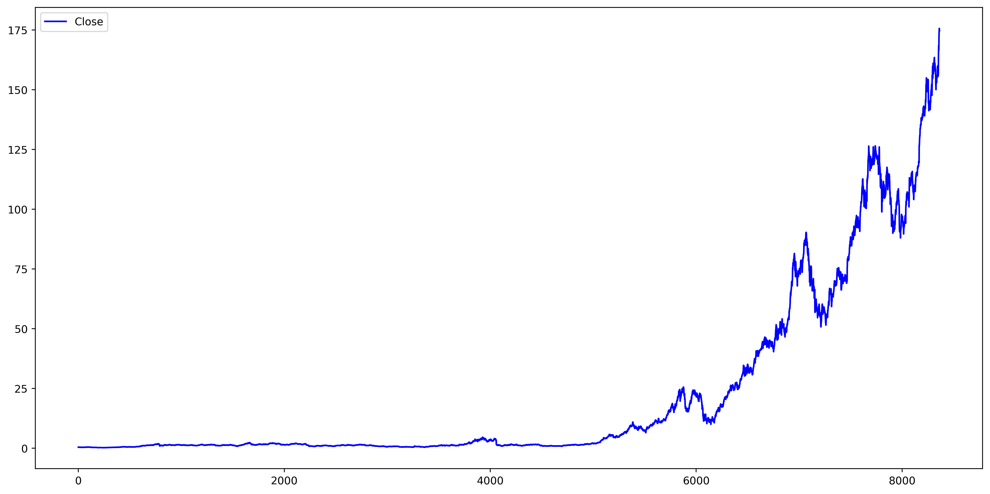
Why KNN and not Linear Regression?
Linear regression would be chosen only if it is close to the reality that we are trying to model, this is clearly not the case for stocks. Stocks are highly volatile and rarely follow a linear relationship with time.

Slide 5
Strengths of KNN
Flexible
Fast
Simple to explain
Notes:
1. Makes no assumption about the data generating process so it can fit flexible models.
2. “Training” the model is as fast as saving the data because it does not need to estimate parameters.
3. It is simple to explain and implement.
https://towardsdatascience.com/k-nearest-neighbors-k-nn-explained-8959f97a8632

Slide 6
Weakness of KNN
Overfitting with small K
Large amount of memory
Prediction is slow
Curse of dimensionality (not so much of a problem for us but can use PCA to lower the dimensionality)
Difficulty in predicting observations spread out in the feature space
Sensitive to outliers
Notes:
Makes no assumption about the data generating process, which can lead to overfitting without sufficient training observations or too small a kvalue.
The data set must be stored where the model can access it, which can use up a large amount of memory with large data sets.
Making predictions is relatively slow compared to parametric models because it needs to compute the distances to the training data points, sort them, retrieve the k closest points, and then make a prediction.
K-NN is a victim of the curse of dimensionality; it does not perform well with high dimensions where data points become very spread out.
K-NN has difficulty with observations spread out in the feature space.
K-NN is sensitive to outliers.

Slide 7
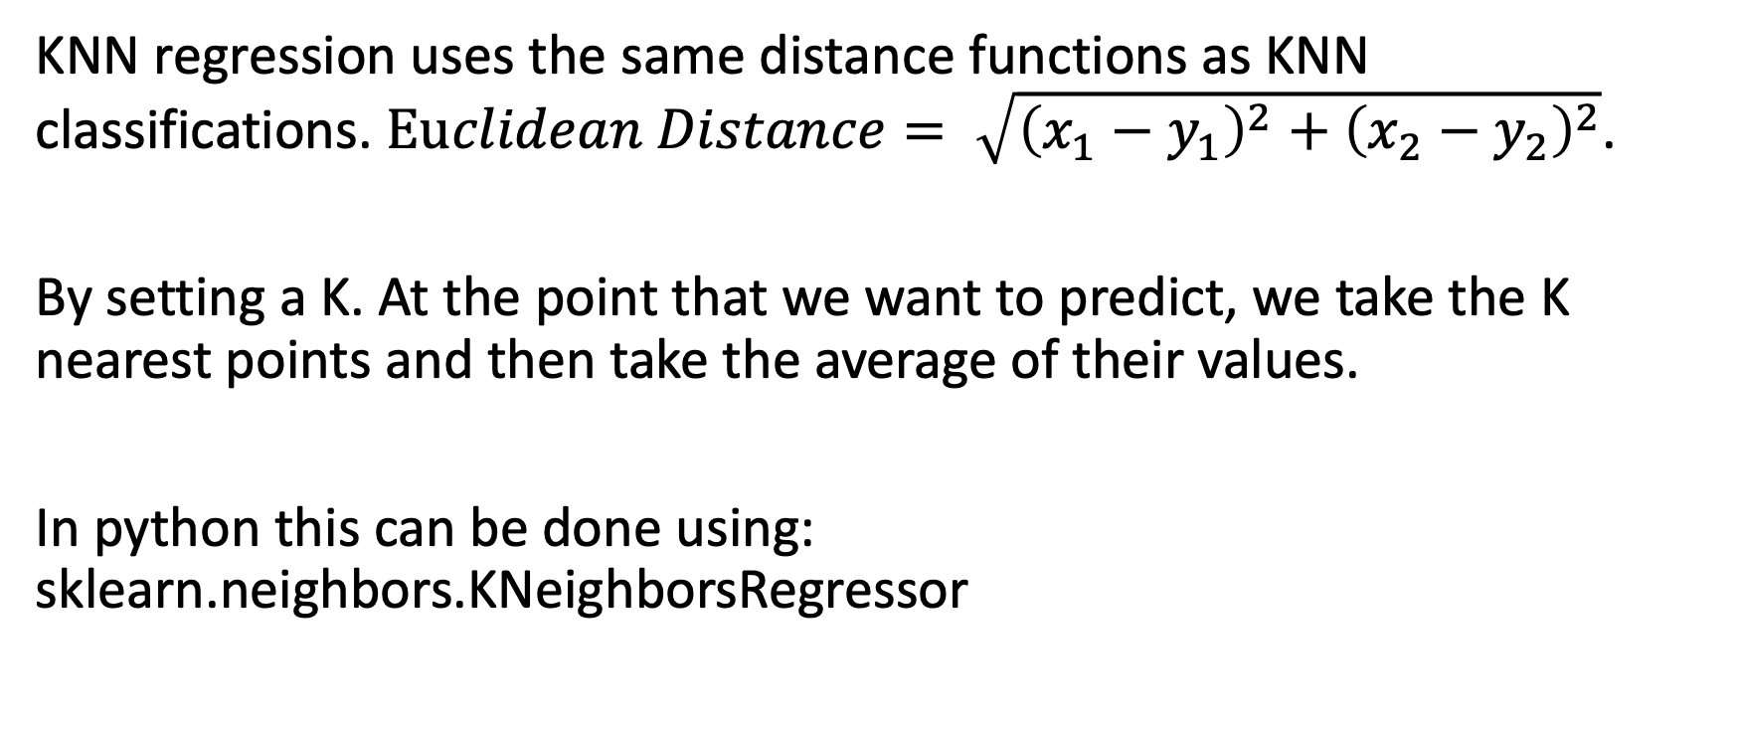
How does KNN regression work?
KNN regression uses the same distance functions as KNN classifications. $Euclidean Distance= \sqrt{{\left(x_{1}−y_{1}\right)}^{2}+{\left(x_{2}−y_{2}\right)}^{2}}$.
By setting a K. At the point that we want to predict, we take the K nearest points and then take the average of their values.
In python this can be done using: sklearn.neighbors.KNeighborsRegressor

Slide 8
sklearn.neighbors.KNeighborsRegressor
Two main parameters to take note:
n_neigbors – The number of neighbors you want.
Weights - {‘uniform’, ‘distance’}
‘uniform’ : All points in each neighborhood are weighted equally. (What we want!)
‘distance’ : Closer neighbors of a query point will have a greater influence than neighbors which are further away.

Slide 9
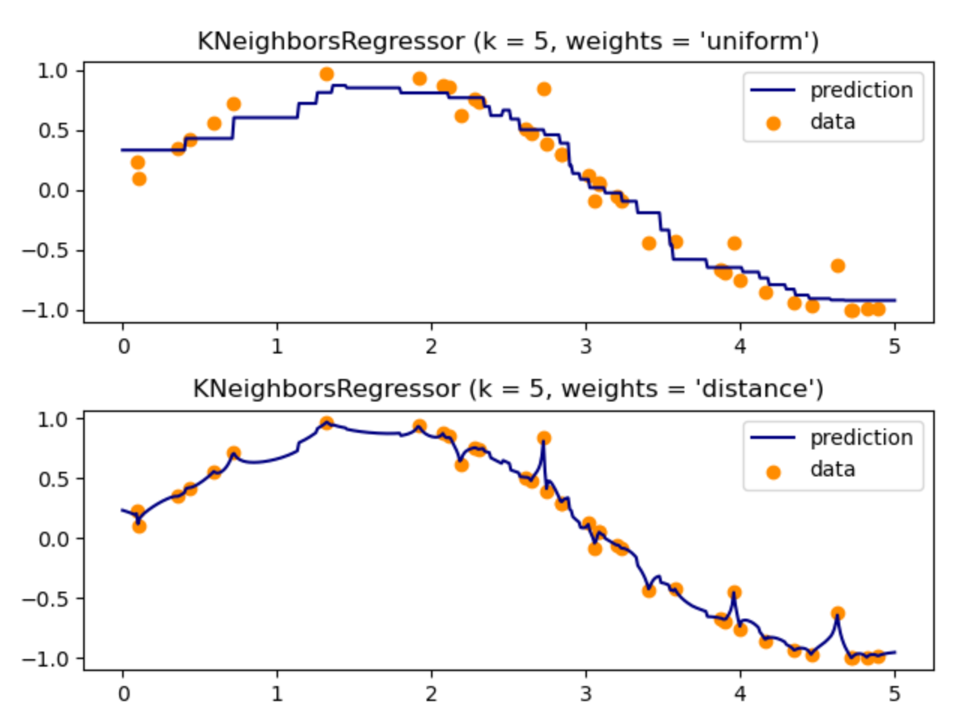
Effect of choosing ‘uniform’ vs ‘distance'
https://scikit-learn.org/stable/auto_examples/neighbors/plot_regression.html

Slide 10
Steps
Normalize the data after splitting the data into its training and testing sets mentioned earlier. This is to avoid data snooping.
Used GridSearchCV from sklearn to automate the tuning of hyperparameters.
Fit the model after finding the optimum K.

Slide 11

GridSearchCV
GridSearchCV is a function that comes in Scikit-learn’s(or SK-learn) model_selection package.
Here, we used a 5-fold cross-validation with {‘n_neighbors’: [2,3]} which means the function will tryout the possible k = 2 or 3.
We limited the K to {2, 3} because one of our training data set has less than 20 instances and we wanted to fix the K used throughout.
Notes:
GridSearchCV is a function that comes in Scikit-learn’s(or SK-learn) model_selection package.So an important point here to note is that we need to have Scikit-learn library installed on the computer. This function helps to loop through predefined hyperparameters and fit your estimator (model) on your training set. So, in the end, we can select the best parameters from the listed hyperparameters.
https://www.analyticsvidhya.com/blog/2018/08/k-nearest-neighbor-introduction-regression-python/

Slide 12


Another way is to observe the elbow
For example, plotting the error for each K
However, this method is not optimal for us since we restricted ourselves to two possible values of k.
Additionally, plotting the elbow curve every time is be a cumbersome and tedious process. You can simply use gridsearch to find the best value.
Notes:
For a very low value of k (suppose k=1), the model overfits on the training data, which leads to a high error rate on the validation set. On the other hand, for a high value of k, the model performs poorly on both train and validation set. If you observe closely, the validation error curve reaches a minima at a value of k = 9. This value of k is the optimum value of the model (it will vary for different datasets). This curve is known as an ‘elbow curve‘ (because it has a shape like an elbow) and is usually used to determine the k value.
https://www.analyticsvidhya.com/blog/2018/08/k-nearest-neighbor-introduction-regression-python/

Slide 13
Why did we choose K = 3?
(1) Variance-Bias Trade-off: While taking the tradeoff into account, we did not want to have too small a k such that it would lead to overfitting.
(2) Limited data points: We were limited to the number of data points in the quarterly data, this meant that we could not have a K that would be bigger than the size of a fold in 5-fold CV.
By (1) and (2), we settled with K = 3.

Slide 14
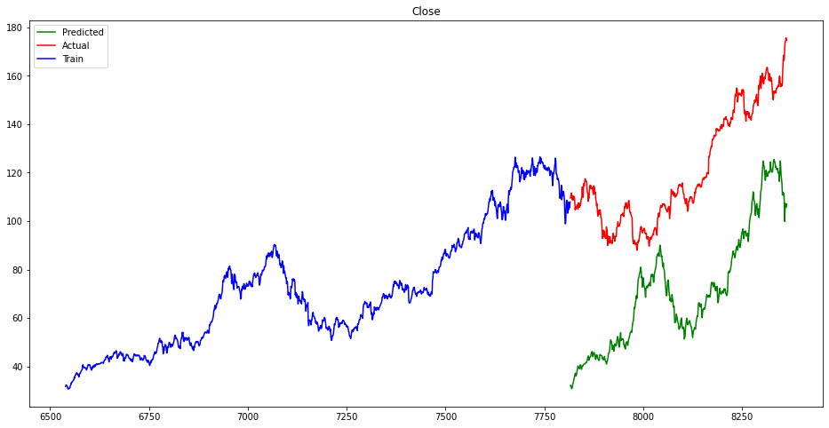
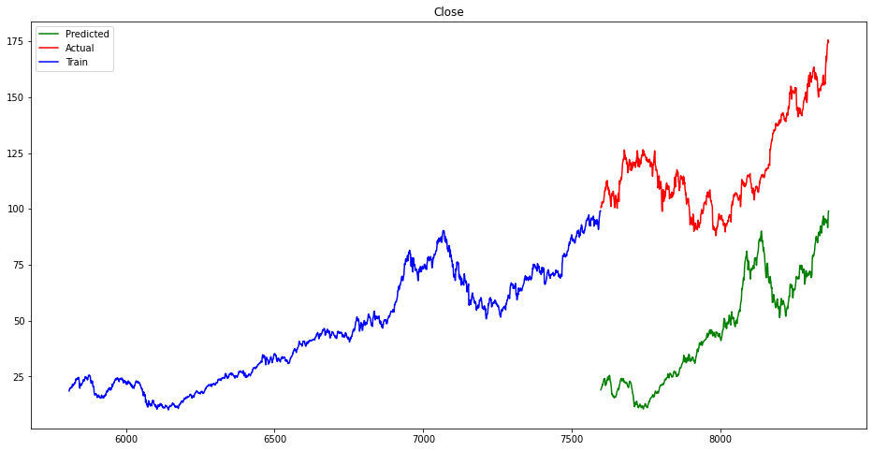
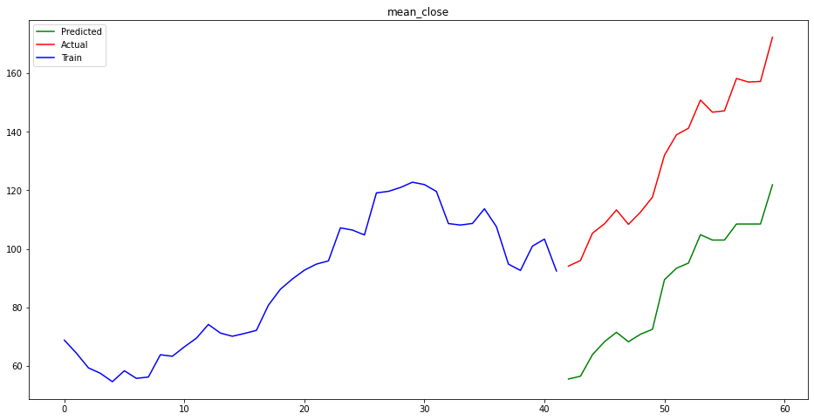
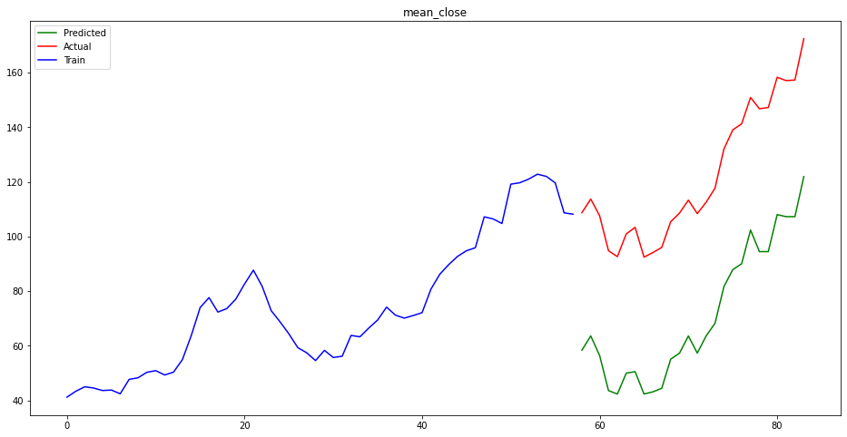
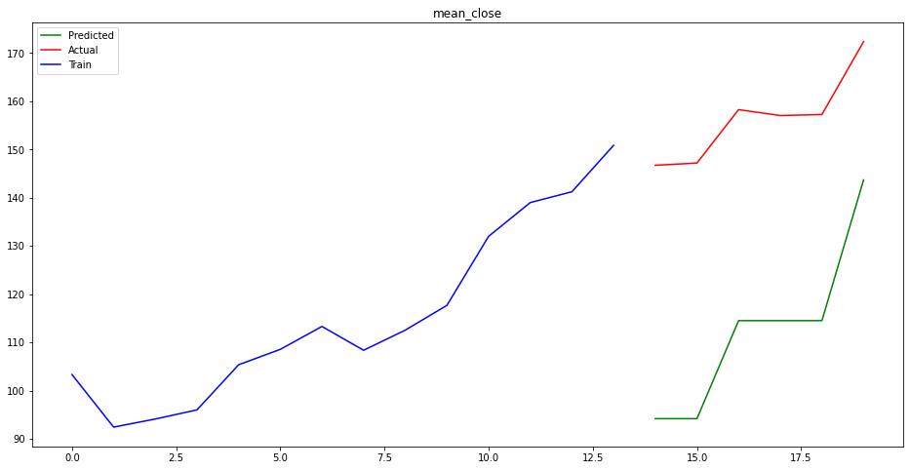
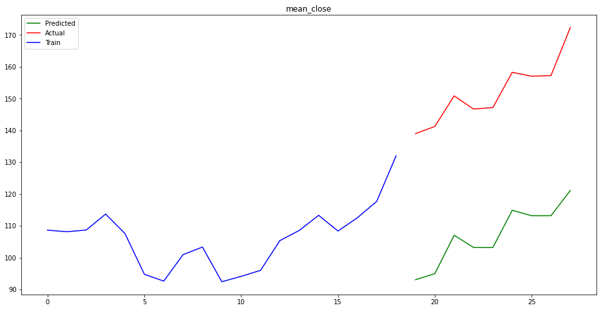
Results
5-year
7-year
Day
Month
Year

Slide 15
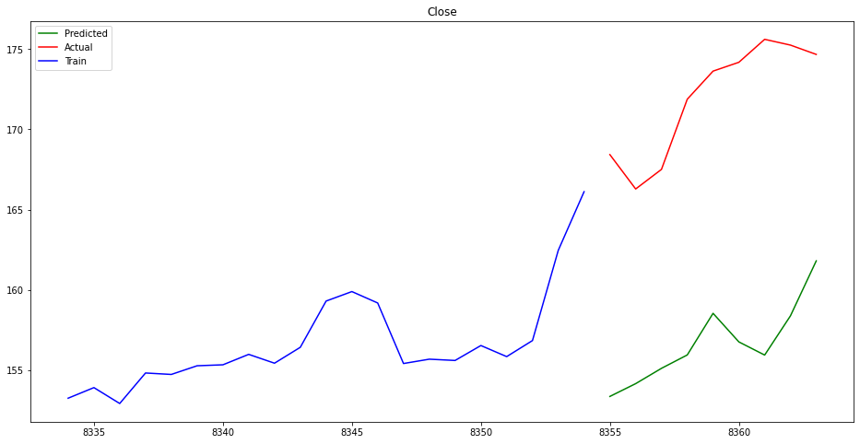
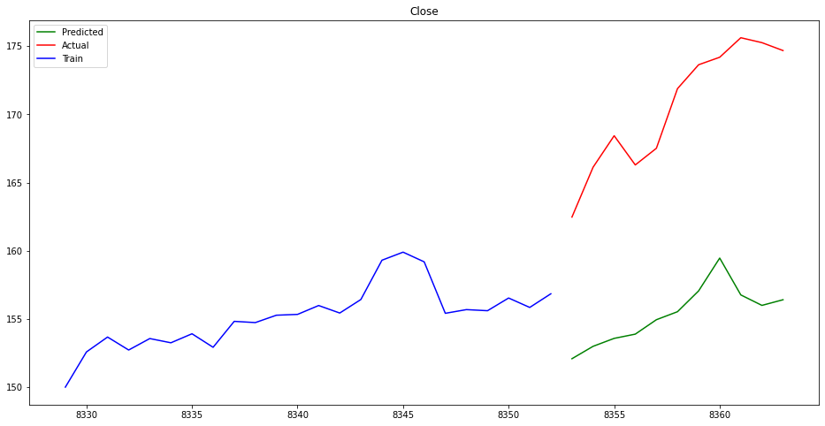
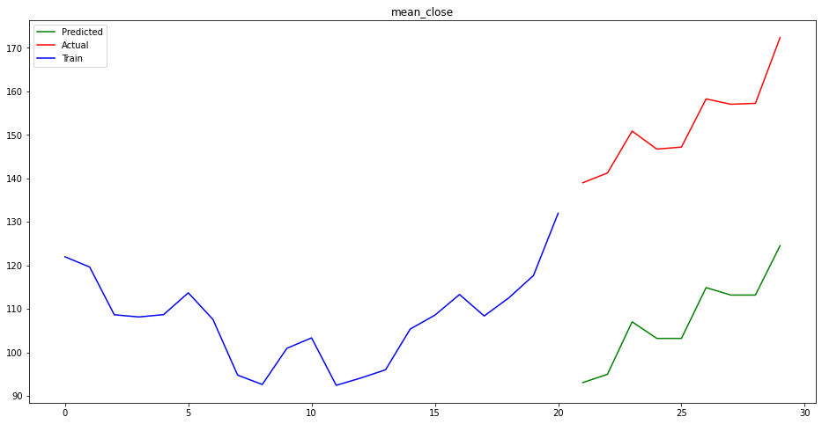
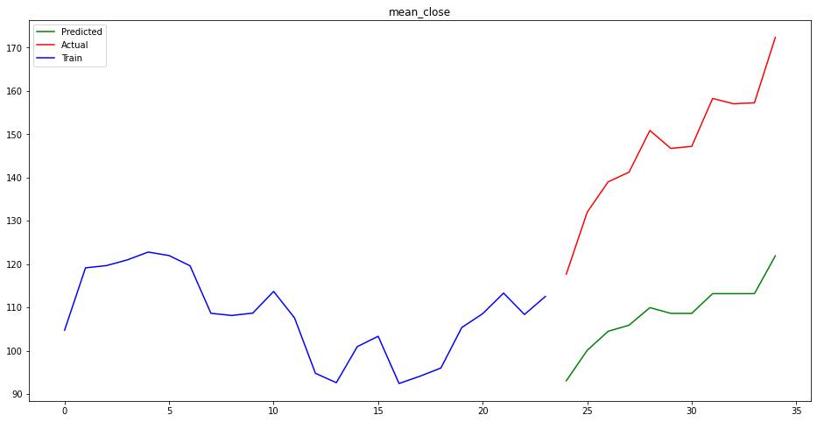
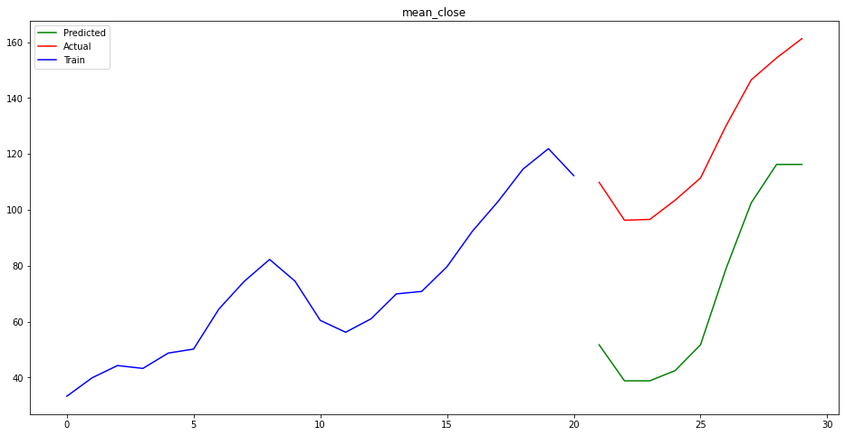
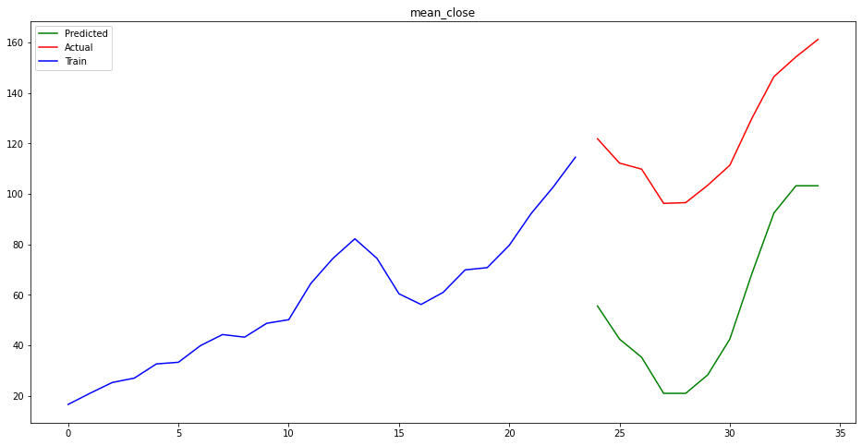
Results
30-points
35-points
Day
Month
Year

Slide 16

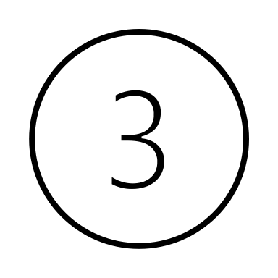

Observations
Common to all predictions, the predicted does not perform well outside the training space (blue).
The predicted result bounded within the range of values of the training.
KNN does not “see” the endpoint and continue the upwards trend. Discontinuous.
Notes:
This is expected as KNN does may not perform well in extrapolating results but more suitable for interpolating.

Slide 17
Performance (RMSE)

Slide 18
Performance (RMSE)
Fix period: RMSE of Day > Month > Quarter (1) This may be due to the variance of the Day > Month > Quarter. Because of the noise, the KNN may be more susceptible to making poorer predictions compared to one that is smoother (Quarter). (2) It could also be that the Quarterly data having less data points which meant that it was easier to overfit and thus achieve lower RMSE.
Fix number of data: RMSE of Day < Month < Quarter (1) The range (max – min) of prices for dataset in Quarter > Month > Day, Quarterly data is predicting more and for a larger range. Since quarterly data would increase more than Month and Day, their corresponding RMSE would be bigger for Quarter then followed by Month and Day.

Slide 19
Limitations
We cannot form a continuous graph.
Poor extrapolation which is key to stock predictions.

